Slide 1
Chapter 12-13 JavaScript Part2
簡廷因 Ting-Ying Chien
2015.12.07

Slide 2
Outline
Chapter 12: Document Object Model (DOM): Objects and Collections
Chapter 13: JavaScript Events

Slide 3
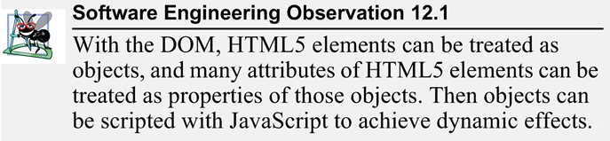
Document Object Model (DOM)

Slide 4
DOM Nodes and Trees
<!DOCTYPE html>
<html>
<head>
<meta charset = "utf-8">
<title>DOM Tree Demonstration</title>
</head>
<body>
<h1>An HTML5 Page</h1>
<p>This page contains some basic HTML5 elements. The DOM tree
for the document contains a DOM node for every element</p>
<p>Here's an unordered list:</p>
<ul>
<li>One</li>
<li>Two</li>
<li>Three</li>
</ul>
</body>
</html>

Slide 5
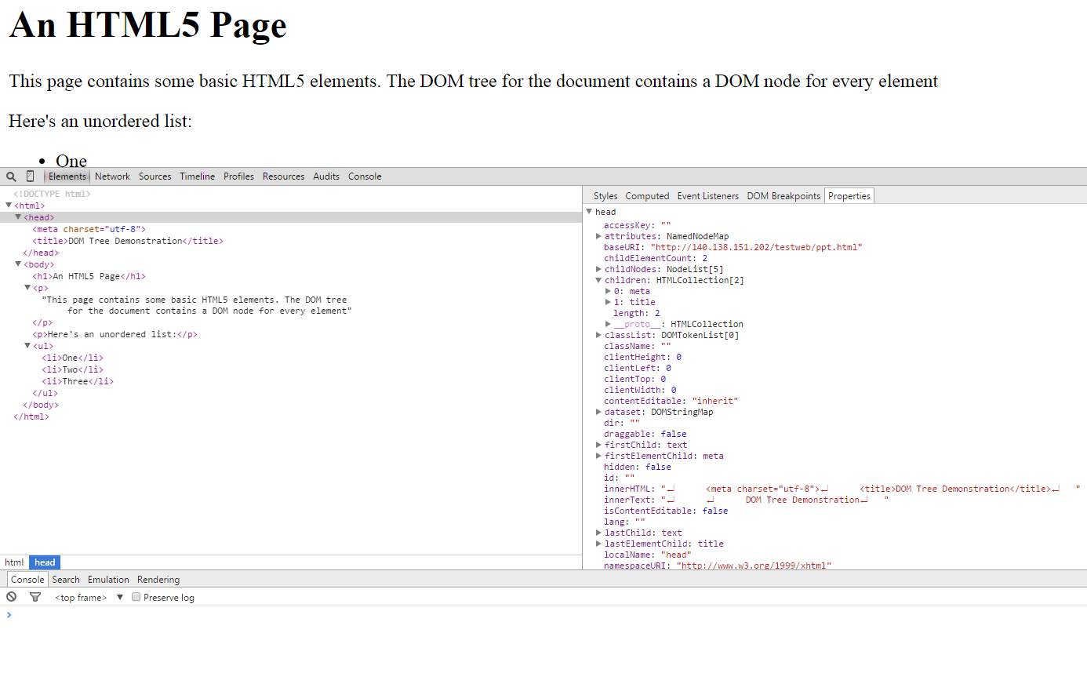
DOM Nodes and Trees
Step1 : press F12 to display developer tools
Step3: select Properties
Step2: click

Slide 6
DOM collections
The DOM contains several collections, which are groups of related objects on a page
Images collection
Links collection
Forms collection
Anchors collection

Slide 7
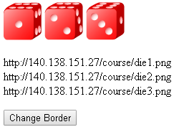
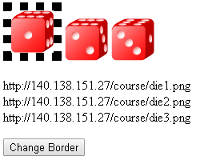
Images collection
<!DOCTYPE html>
<html>
<head>
<meta charset = "utf-8">
<title>Using Images Collection</title>
<script>
function start() {
var button = document.getElementById( "border" );
button.addEventListener( "click", change, false );
var x = document.images;
var txt = "";
for (var i = 0; i < x.length; i++) {
txt = txt + x[i].src + "<br>";
}
document.getElementById("out").innerHTML = txt;
}
function change() {
var x = document.images;
x[0].style.border = "10px dotted black";
}
window.addEventListener( "load", start, false );
</script>
</head>
<body>
<img src="die1.png" alt="1">
<img src="die2.png" alt="2">
<img src="die3.png" alt="3">
<p id="out"></p>
<form action = "#">
<input id = "border" type = "button" value = "Change Border">
</form>
</body>
</html>

Slide 8
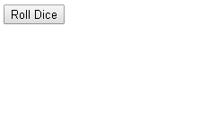
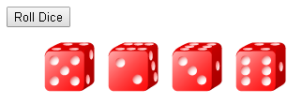
Exercise
Use image collection
Ref : ch6-11.v4.pptx p94-p95
x[0].src = "die1.png"

Slide 9
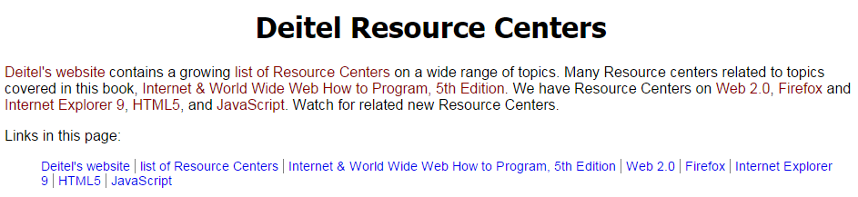
Links collection
From JS
<!DOCTYPE html>
<html>
<head>
<meta charset = "utf-8">
<title>Using Links Collection</title>
<link rel = "stylesheet" type = "text/css" href = "style.css">
<script src = "collections.js"></script>
</head>
<body>
<h1>Deitel Resource Centers</h1>
<p><a href = "http://www.deitel.com/">Deitel's website</a>
contains a growing
<a href = "http://www.deitel.com/ResourceCenters.html">list
of Resource Centers</a> on a wide range of topics. Many
Resource centers related to topics covered in this book,
<a href = "http://www.deitel.com/books/iw3htp5">Internet &
World Wide Web How to Program, 5th Edition</a>. We have
Resource Centers on
<a href = "http://www.deitel.com/Web2.0">Web 2.0</a>,
<a href = "http://www.deitel.com/Firefox">Firefox</a> and
<a href = "http://www.deitel.com/IE9">Internet Explorer 9</a>,
<a href = "http://www.deitel.com/HTML5">HTML5</a>, and
<a href = "http://www.deitel.com/JavaScript">JavaScript</a>.
Watch for related new Resource Centers.</p>
<p>Links in this page:</p>
<div id = "links"></div>
</body>
</html>

Slide 10
Links collection
function processLinks()
{
var linksList = document.links;
var contents = "<ul>";
for ( var i = 0; i < linksList.length; ++i )
{
var currentLink = linksList[ i ];
contents += "<li><a href='" + currentLink.href + "'>" +
currentLink.innerHTML + "</li>";
}
contents += "</ul>";
document.getElementById( "links" ).innerHTML = contents;
}
window.addEventListener( "load", processLinks, false );
<a href = "http://www.deitel.com/"> Deitel's website </a>

Slide 11
Links collection
body { font-family: arial, helvetica, sans-serif; }
h1 { font-family: tahoma, geneva, sans-serif;
text-align: center; }
p a { color: DarkRed; }
ul { font-size: .9em; }
li { display: inline;
list-style-type: none;
border-right: 1px solid gray;
padding-left: 5px; padding-right: 5px; }
li:first-child { padding-left: 0px; }
li:last-child { border-right: none; }
a { text-decoration: none; }
a:hover { text-decoration: underline; }

Slide 12
Forms collect
<!DOCTYPE html>
<html>
<head>
<meta charset = "utf-8">
<title>Using Forms Collection</title>
<script>
function start() {
var button = document.getElementById( "border" );
button.addEventListener( "click", add, false );
}
function add() {
var x = document.forms;
var num1=parseInt(x[0].n1.value);
var num2=parseInt(x[0].n2.value);
document.getElementById( "out" ).innerHTML = num1+num2;
}
window.addEventListener( "load", start, false );
</script>
</head>
<body>
<form action = "#" name="form1">
<input type = "text" name = "n1"> +
<input type = "text" name = "n2">
<input id = "border" type = "button" value = "=">
<span id="out"></span>
</form>
</body>
</html>

Slide 13
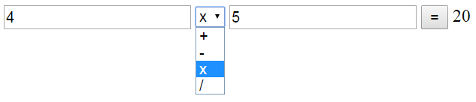
Exercise

Slide 14
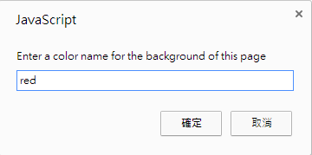
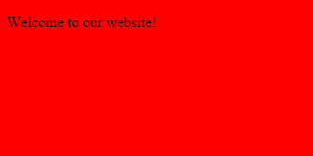
Dynamic styles
<!DOCTYPE html>
<html>
<head>
<meta charset = "utf-8">
<title>Dynamic Styles</title>
<script>
function start()
{
var inputColor = prompt( "Enter a color name for the " +
"background of this page", "" );
document.body.setAttribute( "style",
"background-color: " + inputColor );
}
window.addEventListener( "load", start, false );
</script>
</head>
<body>
<p>Welcome to our website!</p>
</body>
</html>

Slide 15
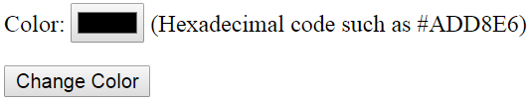
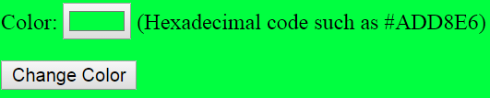
Exercise

Slide 16
Using a Timer and Dynamic Styles to Create Animated Effects
coverviewer.js
var interval = null;
var speed = 6;
var count = 0;
function run()
{
count += speed;
if ( count >= 375 )
{
window.clearInterval( interval );
interval = null;
}
var bigImage = document.getElementById( "imgCover" );
bigImage.setAttribute( "style", "width: " + (0.7656 * count + "px;") +
"height: " + (count + "px;") );
}
function display( imgfile )
{
if ( interval )
return;
var bigImage = document.getElementById( "imgCover" );
bigImage.setAttribute( "style", "width: 0px; height: 0px;" );
bigImage.setAttribute( "src", "fullsize/" + imgfile );
bigImage.setAttribute( "alt", "Large version of " + imgfile );
count = 0;
interval = window.setInterval( "run()", 10 );
}
每10毫秒執行一次run()

Slide 17
Using a Timer and Dynamic Styles to Create Animated Effects
function display( imgfile )
{
if ( interval )
return;
var bigImage = document.getElementById( "imgCover" );
bigImage.setAttribute( "style", "width: 0px; height: 0px;" );
bigImage.setAttribute( "src", "fullsize/" + imgfile );
bigImage.setAttribute( "alt", "Large version of " + imgfile );
count = 0;
interval = window.setInterval( "run()", 10 );
}
coverviewer.js
function start()
{
document.getElementById( "jhtp" ).addEventListener(
"click", function() { display( "jhtp.jpg" ); }, false );
document.getElementById( "iw3htp" ).addEventListener(
"click", function() { display( "iw3htp.jpg" ); }, false );
document.getElementById( "cpphtp" ).addEventListener(
"click", function() { display( "cpphtp.jpg" ); }, false );
document.getElementById( "jhtplov" ).addEventListener(
"click", function() { display( "jhtplov.jpg" ); }, false );
document.getElementById( "cpphtplov" ).addEventListener(
"click", function() { display( "cpphtplov.jpg" ); }, false );
document.getElementById( "vcsharphtp" ).addEventListener(
"click", function() { display( "vcsharphtp.jpg" ); }, false );
}
window.addEventListener( "load", start, false );

Slide 18
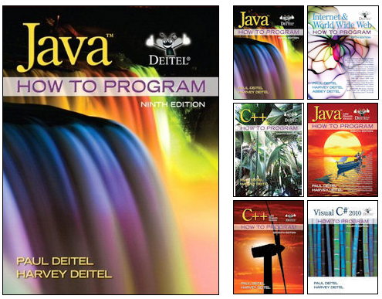
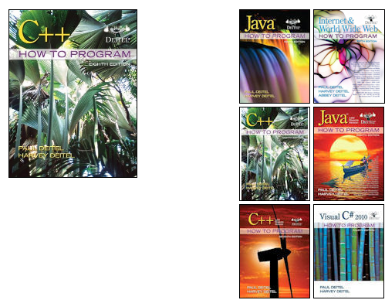
Using a Timer and Dynamic Styles to Create Animated Effects
<!DOCTYPE html>
<html>
<head>
<meta charset = "utf-8">
<title>Deitel Book Cover Viewer</title>
<link rel = "stylesheet" type = "text/css" href = "style.css">
<script src = "coverviewer.js"></script>
</head>
<body>
<div id = "mainimg">
<img id = "imgCover" src = "fullsize/jhtp.jpg"
alt = "Full cover image">
</div>
<div id = "thumbs">
<img src = "thumbs/jhtp.jpg" id = "jhtp"
alt = "Java How to Program cover">
<img src = "thumbs/iw3htp.jpg" id = "iw3htp"
alt = "Internet & World Wide Web How to Program cover">
<img src = "thumbs/cpphtp.jpg" id = "cpphtp"
alt = "C++ How to Program cover">
<img src = "thumbs/jhtplov.jpg" id = "jhtplov"
alt = "Java How to Program LOV cover">
<img src = "thumbs/cpphtplov.jpg" id = "cpphtplov"
alt = "C++ How to Program LOV cover">
<img src = "thumbs/vcsharphtp.jpg" id = "vcsharphtp"
alt = "Visual C# How to Program cover">
</div>
</body>
</html>

Slide 19
Using a Timer and Dynamic Styles to Create Animated Effects
http://140.138.77.210/course/ch12.zip
style.css
#thumbs { width: 192px;
height: 370px;
padding: 5px;
float: left; }
#mainimg { width: 289px;
padding: 5px;
float: left; }
#imgCover { height: 373px; }
img { border: 1px solid black; }

Slide 20
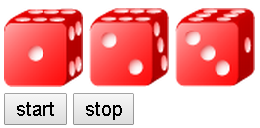
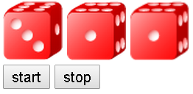
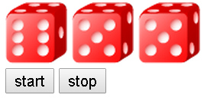
Exercise
Using a timer to display random images
Hint:
interval = window.setInterval( "run()", 50 );
click
click

Slide 21
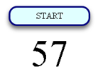
Exercise
Create a countdown timer
Form 60 to 0
Hint:
setInterval
cleanInterval

Slide 22
Event

Slide 23
Introduction
JavaScript events
allow scripts to respond to user interactions and modify the page accordingly
Events and event handling
help make web applications more dynamic and interactive

Slide 24
Reviewing the load Event
The window object’s load event fires when the window finishes loading successfully (i.e., all its children are loaded and all external files referenced by the page are loaded)
Every DOM element has a load event, but it’s most commonly used on the window object.

Slide 25

Reviewing the load Event
<!DOCTYPE html>
<html>
<head>
<meta charset = "utf-8">
<title>load Event</title>
<style type = "text/css">
span { font-weight: bold; }
</style>
<script>
var seconds = 0;
function startTimer() {
window.setInterval( "updateTime()", 1000 );
}
function updateTime(){
++seconds;
document.getElementById( "soFar" ).innerHTML = seconds;
}
window.addEventListener( "load", startTimer, false );
</script>
</head>
<body>
<p>Seconds you have spent viewing this page so far:
<span id = "soFar">0</span></p>
</body>
</html>

Slide 26
Reviewing the load Event
An event handler is a function that responds to an event.
Assigning an event handler to an event on a DOM node is called registering an event handler
Method addEventListener can be called multiple times on a DOM node to register more than one event-handling method for an event.

Slide 27
Reviewing the load Event
It’s also possible to remove an event listener by calling removeEventListener with the same arguments that you passed to addEventListener to register the event handler.
If a script in the head attempts to get a DOM node for an HTML element in the body, getElementById returns null because the body has not yet loaded

Slide 28
Reviewing the load Event
Two models for registering event handlers
Inline model treats events as attributes of HTML elements
Traditional model assigns the name of the function to the event property of a DOM node
The inline model places calls to JavaScript functions directly in HTML code.
The following code indicates that JavaScript function start should be called when the body element loads:
<body onload = "start()">

Slide 29
Reviewing the load Event
The traditional model uses a property of an object to specify an event handler.
The following JavaScript code indicates that function start should be called when document loads:
document.onload = start();
window.addEventListener( "load", start, false );
<body onload = "start()">
document.onload = start();

Slide 30
Event mouseMove and the event Object
mousemove event occurs whenever the user moves the mouse over the web page
The next example creates a simple drawing program that allows the user to draw inside a table element in red or blue by holding down the Shift key or Ctrl key and moving the mouse over the box.
ctrlKey property contains a boolean which reflects whether the Ctrl key was pressed during the event
shiftKey property reflects whether the Shift key was pressed during the event

Slide 31
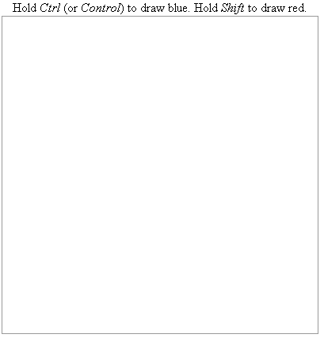
Event mouseMove and the event Object
<!DOCTYPE html>
<html>
<head>
<meta charset = "utf-8">
<title>Simple Drawing Program</title>
<style type = "text/css">
#canvas { width: 400px;
border: 1px solid #999999;
border-collapse: collapse }
td { width: 4px; height: 4px; margin: 0px; padding: 0px; }
.blue { background-color: blue; }
.red { background-color: red; }
</style>
<script src = "draw.js"></script>
</head>
<body>
<table id = "canvas">
<caption>Hold <em>Ctrl</em> (or <em>Control</em>) to draw blue.
Hold <em>Shift</em> to draw red.</caption>
<tbody id = "tablebody"></tbody>
</table>
</body>
</html>

Slide 32
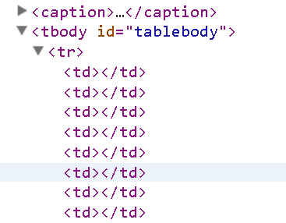
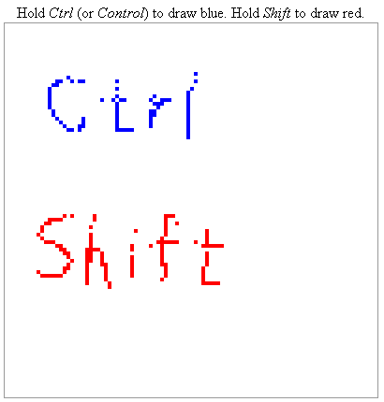
function createCanvas()
{
var side = 100;
var tbody = document.getElementById( "tablebody" );
for ( var i = 0; i < side; ++i )
{
var row = document.createElement( "tr" );
for ( var j = 0; j < side; ++j )
{
var cell = document.createElement( "td" );
row.appendChild( cell );
}
tbody.appendChild( row );
}
document.getElementById( "canvas" ).addEventListener(
"mousemove", processMouseMove, false );
}
function processMouseMove( e )
{
if ( e.target.tagName.toLowerCase() == "td" )
{
if ( e.ctrlKey )
{
e.target.setAttribute( "class", "blue" );
}
if ( e.shiftKey )
{
e.target.setAttribute( "class", "red" );
}
}
}
window.addEventListener( "load", createCanvas, false );

Slide 33
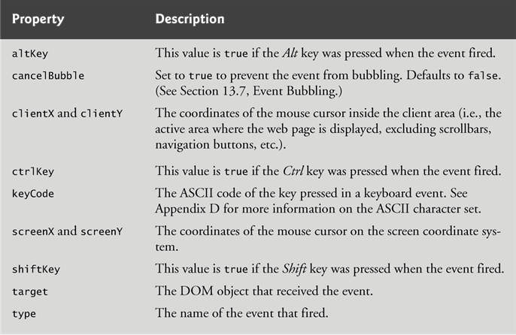
Event mouseMove and the event Object

Slide 34
Event mouseMove and the event Object
KeyCode
http://www.cambiaresearch.com/articles/15/javascript-char-codes-key-codes

Slide 35

Event mouseMove and the event Object
<!DOCTYPE html>
<html>
<head>
<meta charset = "utf-8">
<title>Simple Drawing Program</title>
<script>
function start(){
document.getElementById( "d1" ).addEventListener(
"click", showCoords, false );
}
function showCoords(event) {
var x = event.clientX;
var y = event.clientY;
var coords = "X coords: " + x + ", Y coords: " + y;
document.getElementById("coord").innerHTML = coords;
}
window.addEventListener( "load", start, false );
</script>
<style type = "text/css">
div { width: 400px;
height : 400px;
border: 1px solid #999999;
}
</style>
</head>
<body>
<p id = "coord"></p>
<div id="d1"></div>
</body>
</html>

Slide 36
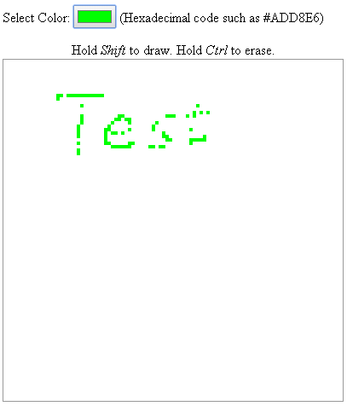
Exercise
Modify p31
add color selector
Hold Shift -> draw color
Hold Ctrl -> erase

Slide 37
Rollovers with mouseover and mouseout
When the mouse cursor enters an element, an mouseover event occurs for that element
When the mouse cursor leaves the element, a mouseout event occurs for that element

Slide 38
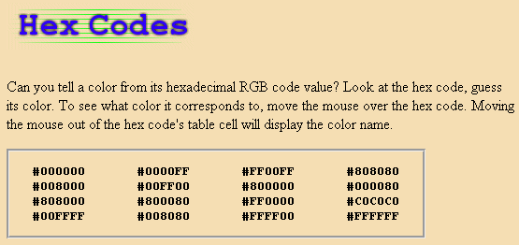


Rollovers with mouseover and mouseout
<!DOCTYPE html>
<html>
<head>
<meta charset = "utf-8">
<title>Events mouseover and mouseout</title>
<style type = "text/css">
body { background-color: wheat }
div { border-style: groove;
text-align: center;
font-family: monospace;
font-weight: bold;
width: 34em; }
ul { margin-left: -40px; }
li { display: inline-block; width: 8em; }
</style>
<script src = "mouseoverout.js"></script>
</head>
<body>
<h1><img src = "heading1.png" id = "heading" alt = "Heading Image"></h1>
<p>Can you tell a color from its hexadecimal RGB code value? Look at the hex code, guess
its color. To see what color it corresponds to, move the mouse over the hex code.
Moving the mouse out of the hex code's table cell will display the color name.</p>
<div>
<ul>
<li id = "Black">#000000</li><li id = "Blue">#0000FF</li>
<li id = "Magenta">#FF00FF</li><li id = "Gray">#808080</li>
<li id = "Green">#008000</li><li id = "Lime">#00FF00</li>
<li id = "Maroon">#800000</li><li id = "Navy">#000080</li>
<li id = "Olive">#808000</li><li id = "Purple">#800080</li>
<li id = "Red">#FF0000</li><li id = "Silver">#C0C0C0</li>
<li id = "Cyan">#00FFFF</li><li id = "Teal">#008080</li>
<li id = "Yellow">#FFFF00</li><li id = "White">#FFFFFF</li>
</ul>
</div>
</body>
</html>
heading1.png
heading2.png

Slide 39
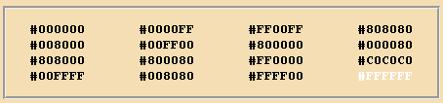
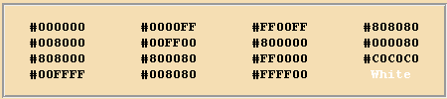


Rollovers with mouseover and mouseout
image1 = new Image();
image1.src = "heading1.png";
image2 = new Image();
image2.src = "heading2.png";
function mouseOver( e )
{
if ( e.target.getAttribute( "id" ) == "heading" )
{
e.target.setAttribute( "src", image2.getAttribute( "src" ) );
}
if ( e.target.tagName.toLowerCase() == "li" )
{
e.target.setAttribute( "style",
"color: " + e.target.getAttribute( "id" ) );
}
}
function mouseOut( e )
{
if ( e.target.getAttribute( "id" ) == "heading" )
{
e.target.setAttribute( "src", image1.getAttribute( "src" ) );
}
if ( e.target.tagName.toLowerCase() == "li" )
{
e.target.innerHTML = e.target.getAttribute( "id" );
}
}
document.addEventListener( "mouseover", mouseOver, false );
document.addEventListener( "mouseout", mouseOut, false );

Slide 40
Form Processing with focus and blur
focus event fires when an element gains focus
i.e., when the user clicks a form field or uses the Tab key to move between form elements
blur fires when an element loses focus
i.e., when another control gains the focus

Slide 41
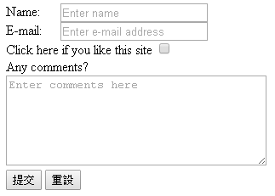
Form Processing with focus and blur
<!DOCTYPE html>
<html>
<head>
<meta charset = "utf-8">
<title>A Form Using focus and blur</title>
<style type = "text/css">
textarea { width: 300px; height: 100px; }
label.fixed { width: 4em; float: left; }
#helpText { font-family: sans-serif; color: blue; margin-top: 10px; }
p { margin: 0; }
</style>
<script src = "focusblur.js"></script>
</head>
<body>
<form id = "myForm" action = "">
<p><label class = "fixed" for = "name">Name:</label>
<input type = "text" id = "name"
placeholder = "Enter name"></p>
<p><label class = "fixed" for = "email">E-mail:</label>
<input type = "email" id = "email"
placeholder = "Enter e-mail address"></p>
<p><label>Click here if you like this site
<input type = "checkbox" id = "like"></label></p>
<p><label for = "comments">Any comments?</p>
<textarea id = "comments"
placeholder = "Enter comments here"></textarea>
<p><input id = "submit" type = "submit">
<input id = "reset" type = "reset"></p>
</form>
<p id = "helpText"></p>
</body>
</html>

Slide 42
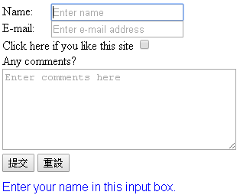
Form Processing with focus and blur
var helpArray = [ "Enter your name in this input box.",
"Enter your e-mail address in the format user@domain.",
"Check this box if you liked our site.",
"Enter any comments here that you'd like us to read.",
"This button submits the form to the server-side script.",
"This button clears the form.", "" ];
var helpText;
function init()
{
helpText = document.getElementById( "helpText" );
registerListeners(document.getElementById( "name" ), 0 );
registerListeners(document.getElementById( "email" ), 1 );
registerListeners(document.getElementById( "like" ), 2 );
registerListeners(document.getElementById( "comments" ), 3 );
registerListeners(document.getElementById( "submit" ), 4 );
registerListeners(document.getElementById( "reset" ), 5 );
}
function registerListeners( object, messageNumber )
{
object.addEventListener( "focus",
function() { helpText.innerHTML = helpArray[ messageNumber ]; },
false );
object.addEventListener( "blur",
function() { helpText.innerHTML = helpArray[ 6 ]; }, false );
}
window.addEventListener( "load", init, false );

Slide 43
More Form Processing with submit and reset
submit and reset events fire when a form is submitted or reset, respectively
The anonymous function executes in response to the user’s submitting the form by clicking the Submit button or pressing the Enter key.

Slide 44
More Form Processing with submit and reset
<!DOCTYPE html>
<html>
<head>
<meta charset = "utf-8">
<title>A Form Using focus and blur</title>
<style type = "text/css">
textarea { width: 300px; height: 100px; }
label.fixed { width: 4em; float: left; }
#helpText { font-family: sans-serif; color: blue; margin-top: 10px; }
p { margin: 0; }
</style>
<script src = "focusblur.js"></script>
</head>
<body>
<form id = "myForm" action = "">
<p><label class = "fixed" for = "name">Name:</label>
<input type = "text" id = "name"
placeholder = "Enter name"></p>
<p><label class = "fixed" for = "email">E-mail:</label>
<input type = "email" id = "email"
placeholder = "Enter e-mail address"></p>
<p><label>Click here if you like this site
<input type = "checkbox" id = "like"></label></p>
<p><label for = "comments">Any comments?</p>
<textarea id = "comments"
placeholder = "Enter comments here"></textarea>
<p><input id = "submit" type = "submit">
<input id = "reset" type = "reset"></p>
</form>
<p id = "helpText"></p>
</body>
</html>

Slide 45
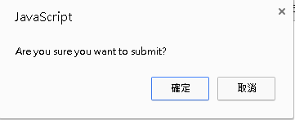
More Form Processing with submit and reset
var helpArray = [ "Enter your name in this input box.",
"Enter your e-mail address in the format user@domain.",
"Check this box if you liked our site.",
"Enter any comments here that you'd like us to read.",
"This button submits the form to the server-side script.",
"This button clears the form.", "" ];
var helpTextDiv;
function init()
{
helpTextDiv = document.getElementById( "helpText" );
registerListeners(document.getElementById( "name" ), 0 );
registerListeners(document.getElementById( "email" ), 1 );
registerListeners(document.getElementById( "like" ), 2 );
registerListeners(document.getElementById( "comments" ), 3 );
registerListeners(document.getElementById( "submit" ), 4 );
registerListeners(document.getElementById( "reset" ), 5 );
var myForm = document.getElementById( "myForm" );
myForm.addEventListener( "submit",
function() { return confirm( "Are you sure you want to submit?" ); }, false );
myForm.addEventListener( "reset",
function() { return confirm( "Are you sure you want to reset?" ); }, false );
}
function registerListeners( object, messageNumber )
{
object.addEventListener( "focus",
function() { helpTextDiv.innerHTML = helpArray[ messageNumber ]; },false );
object.addEventListener( "blur",
function() { helpTextDiv.innerHTML = helpArray[ 6 ]; }, false );
}
window.addEventListener( "load", init, false );

Slide 46
More Form Processing with submit and reset
confirm method asks the users a question, presenting them with an OK button and a Cancel button
If the user clicks OK, confirm returns true; otherwise, confirm returns false

Slide 47
More Events
The following slide lists some common events and their descriptions. The actual DOM event names begin with "on", but we show the names you use with addEventListener here
window.addEventListener( "load", start, false );
<body onload = "start()">
document.onload = start();

Slide 48
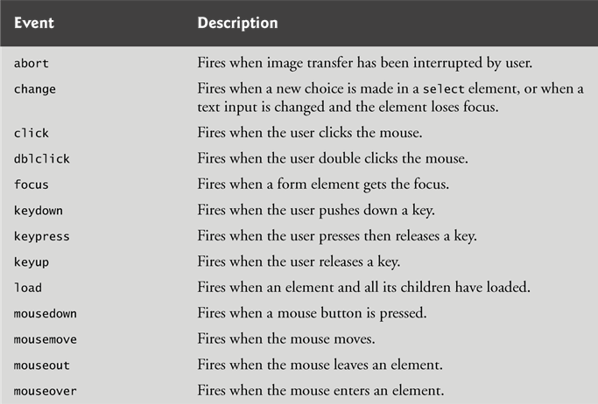
More Events

Slide 49
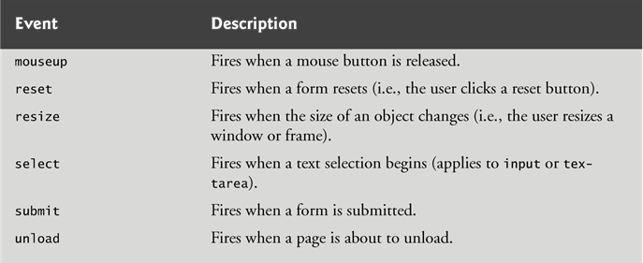
More Events

Slide 50
Exercise
Poke Draw
http://www.pokedraw.net/
Random image
http://www.pokedraw.net/img/100.png ~150.png
Click button (by CSS)
Timer control
A draw panel (ref ch12-13.v2 p35)
New start -> clear panel

Slide 51
Exercise
function clearCanvas()
{
var tablebody = document.getElementById( "tablebody" )
var tableParent = tablebody.parentNode;
tableParent.removeChild( tablebody );
var newTableBody = document.createElement( "tbody" );
newTableBody.id = "tablebody";
tableParent.appendChild( newTableBody );
createCanvas();
}

Slide 52
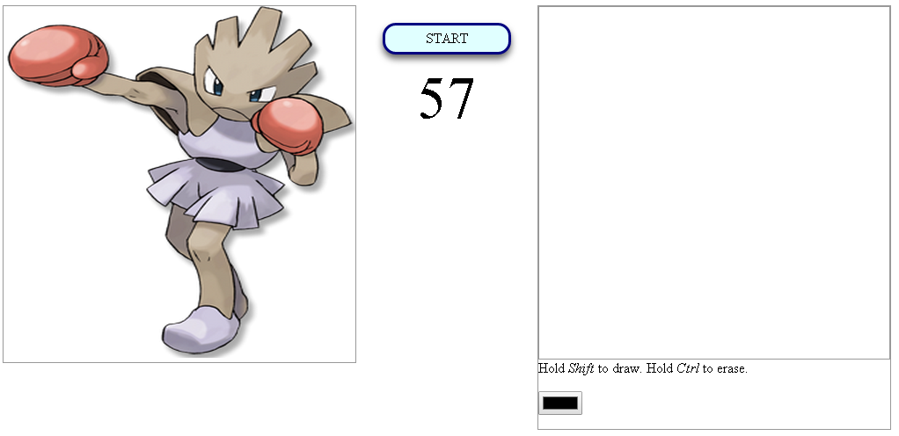
Exercise

